Slide 1

BVRIT HYDERABAD College of Engineering for Women
SEMINAR
ON
FINGER READER
- S. NISCHALA
- 18WH5A0506
- IV YEAR CSE-A
- COMPUTER SCIENCE AND ENGINEERING

Slide 2
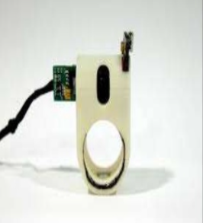
FINGER READER:
A WEARABLE DEVICE TO SUPPORT TEXT READING ON TO GO..

Slide 3
CONTENTS:
ABSTRACT
INTRODUCTION
HARDWARE DETAILS
SOFTWARE DETAILS
COMPONENTS
IMPLEMENTATION
WORKING
ADVANTAGES

Slide 4
DISADVANTAGES
APPLICATIONS
FUTURE WORK
CONCLUSION
REFERENCES

Slide 5
ABSTRACT:
Accessing printed text in a mobile context is a major challenge for the blind. A preliminary study with blind people reveals numerous difficulties with existing state-of-the-art technologies including problems with alignment, focus, accuracy, mobility and efficiency. In this paper, we introduced a finger-worn device, FingerReader that assists blind users with reading printed text.
We introduce a novel computer vision algorithm for local sequential text scanning that enables reading single lines, blocks of text or skimming the text with complementary, multimodal feedback. This system is implemented in a small finger worm form factor that enables a more manageable eyes-free operation with trivial setup.

Slide 6
INTRODUCTION:
DR. Pattie Maes, founder and director of the MIT Media Lab’s Fluid Interfaces research group, who developed FingerReader.
The Finger Reader is a 3D printed ring-like device worn on the index Finger.
It has a small camera on the top which scans printed text and monitors finger movements.
Finger-worn interface for interaction.
Finger reader is a device that assists visually impaired users with reading texts or words.

Slide 7
The design continues the work we have done on the eye ring.
However this work features novel hardware and software that includes haptic response, video-processing algorithms and different output modalities.
The finger worn design helps focus the camera at a fixed distance and utilizes the sense of touch when scanning the surface.
Additionally, the device doesn’t have many buttons or parts in order to provide a simple interface for users and easily orient the device.

Slide 8
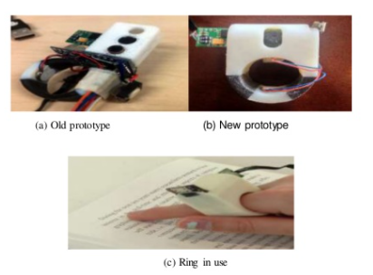
Figure 2: Types of Finger Reader Prototypes.

Slide 9
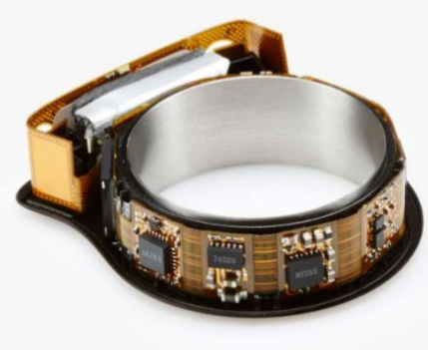
TECHNOLOGIES USED:
HARDWARE DETAILS: The finger Reader hardware was designed using:
Multimodal feedback via vibration motors.
A new dual-material case design.
A high-resolution mini video camera.

Slide 10
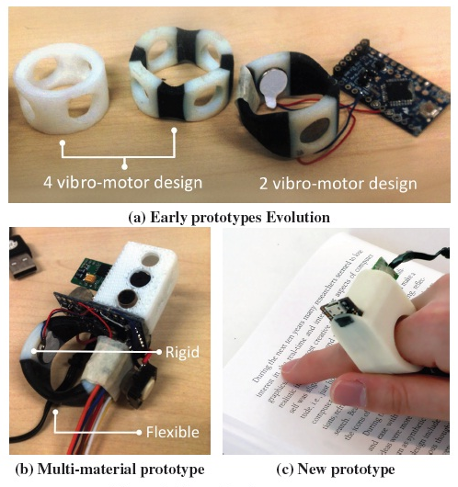

Slide 11
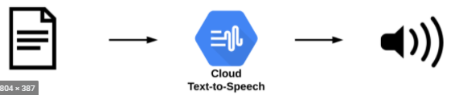
SOFTWARE DETAILS:
To accompany the hardware, a software stack that includes:
A text extraction algorithm.
Hardware control driver.
Integration layer with Tesseract OCR.
File Text-to-Speech(TTS).

Slide 12
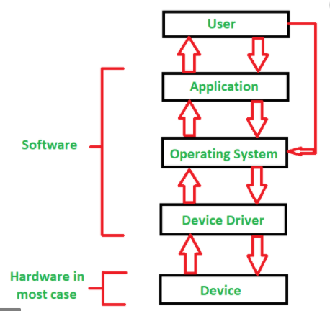
Figure 6 : Flow of the hardware control driver.

Slide 13
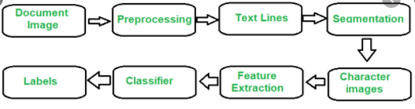
Figure 7: Flow Diagram of OCR.

Slide 14
COMPONENTS:
TTL Serial JPEG Camera.
16 MHz AVR PROCESSOR.
A Bluetooth module.
3.7V polymer Lithium –ion battery.
3.3V regulator.
A push button switch.

Slide 15
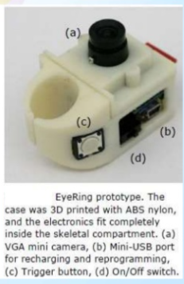
IMPLEMENTATION:
All these components are packaged into a wearable ABS nylon casing.

Slide 16
WORKING:
A finger-worn device with an embedded camera, a computation element and an earpiece for information loopback.
Autonomous and wireless, and includes a single button to initiate the interaction.
Speech processing engine and computer vision engine were implemented on a mobile phone.
User would single click the pushbutton switch on the side if the ring using his thumb.
A snapshot is taken from the camera and the image is transferred via Bluetooth to phone.
Mobile phone then analyzes the images using our computer vision engine.

Slide 17
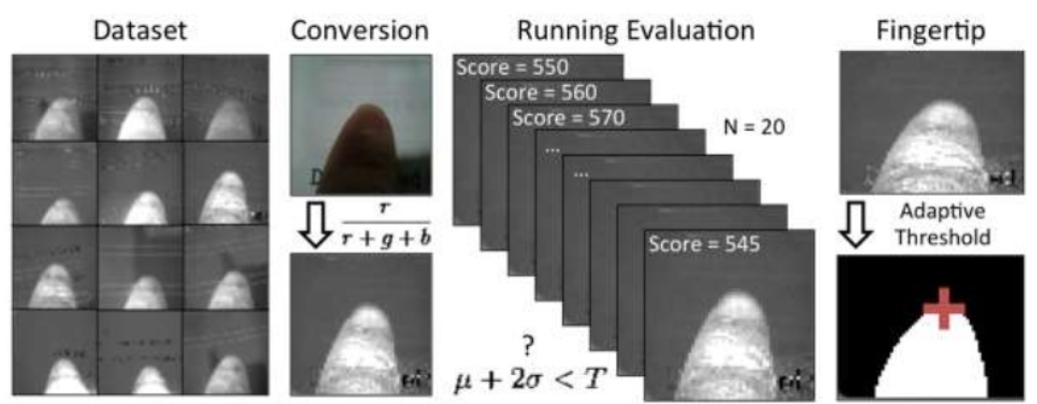
Figure 5: Scene and Finger Detection.

Slide 18
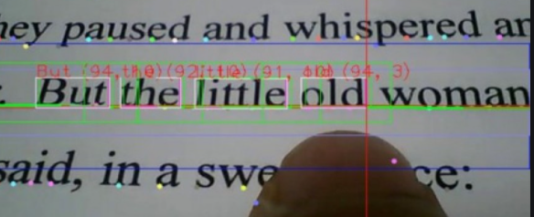
WORKING..
Then the android application uses a TTS module to readout the information through a headset.
A novel-tracking based algorithm extracts text locally and sequentially, rather than in whole text blocks and pages like many existing devices use.

Slide 19
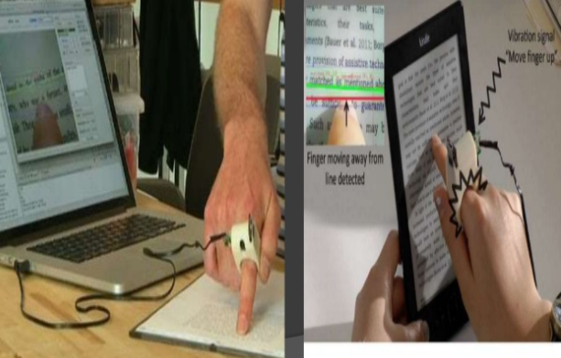
Working…
If the user veers away from a text line, tactile feedback is provided by two vibration motors embedded in the 3D printed case.
Auditory cues alert the user at the beginning and the end of reading passages.

Slide 20
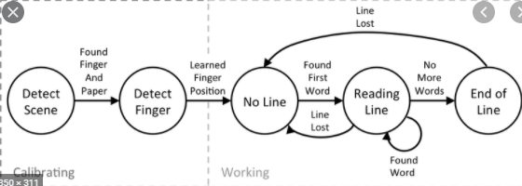
Figure 8: Sequential text reading algorithm state machine.

Slide 21
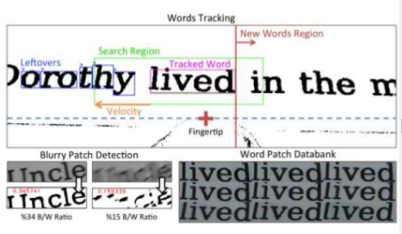
Figure 9: Words Tracking process.

Slide 22
ADVANTAGES:
The Finger Reader wearable health device can help them gain access to a greater number of learning resources and contribute greatly to their quality of life.
The index-finger worn device is more flexible.
A lot more immediate than any solution that they have right now.

Slide 23
DISADVANTAGES:
The camera doesn’t auto-focus, making it hard to adjust to different finger lengths.
The OCR is limited to language recognition.
There is lot of effort that is required to make trainer data of different languages and implement that.

Slide 24
APPLICATIONS:
Virtual Walking Cane:
Used for navigation is certainly fashionable and appealing.
Reading Non-Braille:
Visually impaired people are mostly bound to reading Braille or listening to audio books but are limited. This will allows the user to read regular printed material using this ring.
Tourist Helper :
tourists visiting a new city often rely on maps and landmarks for navigation.

Slide 25
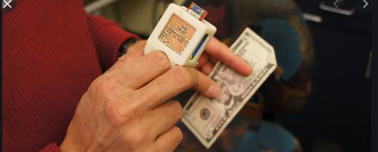
CURRENCY DETECTOR:
Intended to help the user to identify currency bills.
Simply point index finger to a currency note and click the button to deliver an image for processing.
A detection algorithm based on a Bag of Visual Words (BoVW) scans the image and makes a decision.
We use Opponent Space SURF features to retain color information for notes detection.

Slide 26
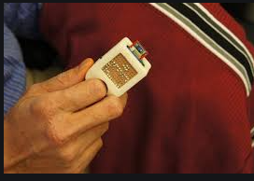
COLOR DETECTOR:
Aids a visually impaired person to understand the color of an object.
Users simply touch point to an object and click the button to delivery an image for processing.
Analyses the image and returns the average color via audio feedback.
We use a calibration step to help the system adjust to different lighting conditions.

Slide 27
FUTURE WORK:
Future Applications will included that adding more hardware such as a microphone, an infrared light source or a laser module, a second camera, a depth sensor or inertial sensors, will open up a multitude of new uses for this specific wearable design.

Slide 28
CONCLUSION:
Finger Reader presents a new way for VI to read printed text locally and sequentially rather than in blocks like existing technologies dictate.
The design is motivated by a user needs study that shows the benefit in using continuous multimodal feedback for text scanning, which again shows in a qualitative analysis we performed.

Slide 29
REFERENCES:
https://www.slideshare.net/SarveshMeena/finger-reader-thesis-and-seminar-report
Blindsight, Text detective, 2013 http://blindsight.com/textdetective/.
https://www.seminarsonly.com/computer%20science/finger-reader-seminar-report-ppt.php
G. Tejaswani, Afroz. B, Shruthi. Y, Sunitha .S, Agriculture Robotics , International Journal of Engineering and Computer Science: Vol. 7 No. 03 (2018).

Slide 30
THANK YOU!

